Slide 1

CS-M151B
Computer Systems Architecture
Blaise Tine
UCLA Computer Science

Slide 2

Attendance

Slide 3
ISA Classification
Organizing ISAs based on their characteristics
Instruction Complexity
Addressing mode
Encoding style
Parallelism

Slide 4
ISA Classification
Instruction complexity
CISC: Complex instruction set computing
RISC: Relaxed instruction set computing

Slide 5
ISA Classification
CISC Characteristics
Small register File
Large number of instructions
Some instructions are complex (can perform multiple operations, taking several cycles).
e.g. x86 string instructions: LODS, STOS
Complex addressing modes
immediate, register, memory
Complex data types
string, complex numbers
Variable-length instructions
Enables compact representation

Slide 6
ISA Classification
CISC Design Motivations
Reducing register file
Transistor cost was high
Reducing program size
Memory was very expensive
Complex instructions
Simplify assembly programming
Compilers were very primitive

Slide 7
ISA Classification
RISC Characteristics
Smaller set of instructions
Optimized instructions to execute in single clock
Uniform instruction format
Identical general purpose registers
Simple address mode
Fewer data type
Fixed-Length Instruction
Simplify instruction decoding

Slide 8
ISA Classification
RISC Design Motivations
Simpler was often faster
Complex instructions took more time than multiple simpler ones
Memory got cheaper and larger
Could store more instructions
Transistors got cheaper
Could afford larger register file
Compiler got better
Move complexity to the compiler
How did Intel address the shortcoming of CISC?

Slide 9
ISA Classification
Intel solutions
Intel cannot drop CISC
Legacy software and operating systems
Some critical applications cannot be modified (no sources)
Introducing a new ISA versus licensing ARM both costly
Introduce RISC-like microarchitecture
Translate CISC into RISC micro-ops

Slide 10
ISA Classification
CISC-like ISA is still relevant today
Domain-specific accelerators
e.g. Google TPU’s MatrixMul instruction
TPU paper:
https://dl.acm.org/doi/pdf/10.1145/3079856.3080246

Slide 11
ISA Classification
Parallelism
VLIW ISA
Vector ISA

Slide 12
ISA Classification
VLIW ISA (Very Long Instruction Word)
Encode multiple operations into a single long instruction word
The idea is to execute each operation on a different execution unit in parallel
Example: Intel IA64 (2001)
[Load R1, Add R2, Store R3, NOP]
Static instruction scheduling
The compiler is responsible to ensuring that that all operations within the instruction have no dependencies and can execute in parallel.

Slide 13
ISA Classification
VLIW ISA (Very Long Instruction Word)
Need multiple fetches to get a long instruction?
No, relies on wide data bus (e.g. 64-bit)
Otherwise, fetch will be too slow

Slide 14
ISA Classification
VLIW ISA Design Motivation
Hardware simplification
Move the complexity of instruction scheduling to the compiler
No need to worry about data dependency
High Parallelism
Enable multiple operations to execute in parallel
Exploit Instruction-level parallelism (ILP)

Slide 15
ISA Classification
VLIW ISA Shortcomings
Compiler complexity
Expensive if hardware changes
Portability
Too much coupling with hardware
Process changes renders binary incompatible
Static Scheduling
Limits runtime adaptation
e.g. cache miss, branch prediction, etc…
Code Size
Instructions are typical large, increase memory bandwidth

Slide 16
ISA Classification
Vector ISAs
Single Instruction Multiple Data (SIMD)
Fetch multiple Data at once
Parallel data processing
Examples:
Intel AVX
Vfmadd231ps y3, y2, y1, y0
y3₇₋₀ = y0₇₋₀ * y1₇₋₀ + y2₇₋₀
ARM Neon
vmla.f32 v2, v1, v0
v2₃₋₀ += v0₃₋₀ * v1₃₋₀
Vector Register File
ID | DATA0 | DATA1 | DATA2 | DATA3
0 | 0x00FF00FF | 0x00000000 | 0x00FF00FF | 0x00FF00FF
1 | 0xAA008800 | 0xFFFFFFFF | 0x00FF00FF | 0xFFFFFFFF
2 | 0xF0F0F0F0 | 0xF0F0F0F0 | 0xF0F0F0F0 | 0xF0F0F0F0
3 | 0x00000000 | 0x00000000 | 0xFFFFFFFF | 0x00FF00FF

Slide 17
ISA Classification
Vector ISAs Limitations
Memory bandwidth
Increased memory requests
Control-flow limitations
Divergent conditional values
Programmability
Vectorization not always possible
Data alignment restrictions

Slide 18
ISA Classification
Vector ISAs Limitations
Memory bandwidth
Increased memory requests
Control-flow limitations
Divergent conditional values
Programmability
Vectorization not always possible
Data alignment restrictions

Slide 19
The RISC-V ISA
The fifth RISC Instruction Set Architecture
First generation: efficient ISA proposal 80-70’s IBM 801
Second generation: commercialization (SPARC from Sun Microsystems)
Third generation: segmentation (embedded market)
Fourth generation: widespread adoption (ARM)
Fifth generation?
Open standard: no licensing and royalty constraints
Free to use and adapt
Focus: efficiency, extensibility, and accessibility.
Reference Specs: https://riscv.org/wp-content/uploads/2017/05/riscv-spec-v2.2.pdf

Slide 20
RISC-V Extensions
RISC-V composable and Modular design
Base ISAs:
RV32-I – 32-bit integer – this course only
RV64-I – 64-bit integer
RV128-I – 128-bit integer
Notes:
A hypervisor is a host operating system for virtual machines

Slide 21
RISC-V Extensions
Frozen Extensions:
M: multiply and divide – why not including this into Baseline?
C: compressed instructions
F: single-precision floating-point
D: double-precision floating-point
Q: quad-precision floating-point
A: atomics
H: hypervisor
How to compose?
e.g. RV32-IMF includes I, M, and F extensions
Notes:
A hypervisor is a host operating system for virtual machines

Slide 22
RISC-V Extensions
Open Extensions:
V: Vector
P: Packed SIMD – how different from V?
B: Bit manipulation
T: Transactional memory
N: User-level interrupts
J: JIT support
Notes:
Vector: separate register file with multiple lanes of data
Packed SIMD: partition existing data in current register file. e.g A 32-bit data can be represented as 4 x 8-bit elements.
JIT support: garbage collection, context switching
Transactional memory: execute multiple memory operations as a single atomic transaction (e.g. start, commit, abort)

Slide 23
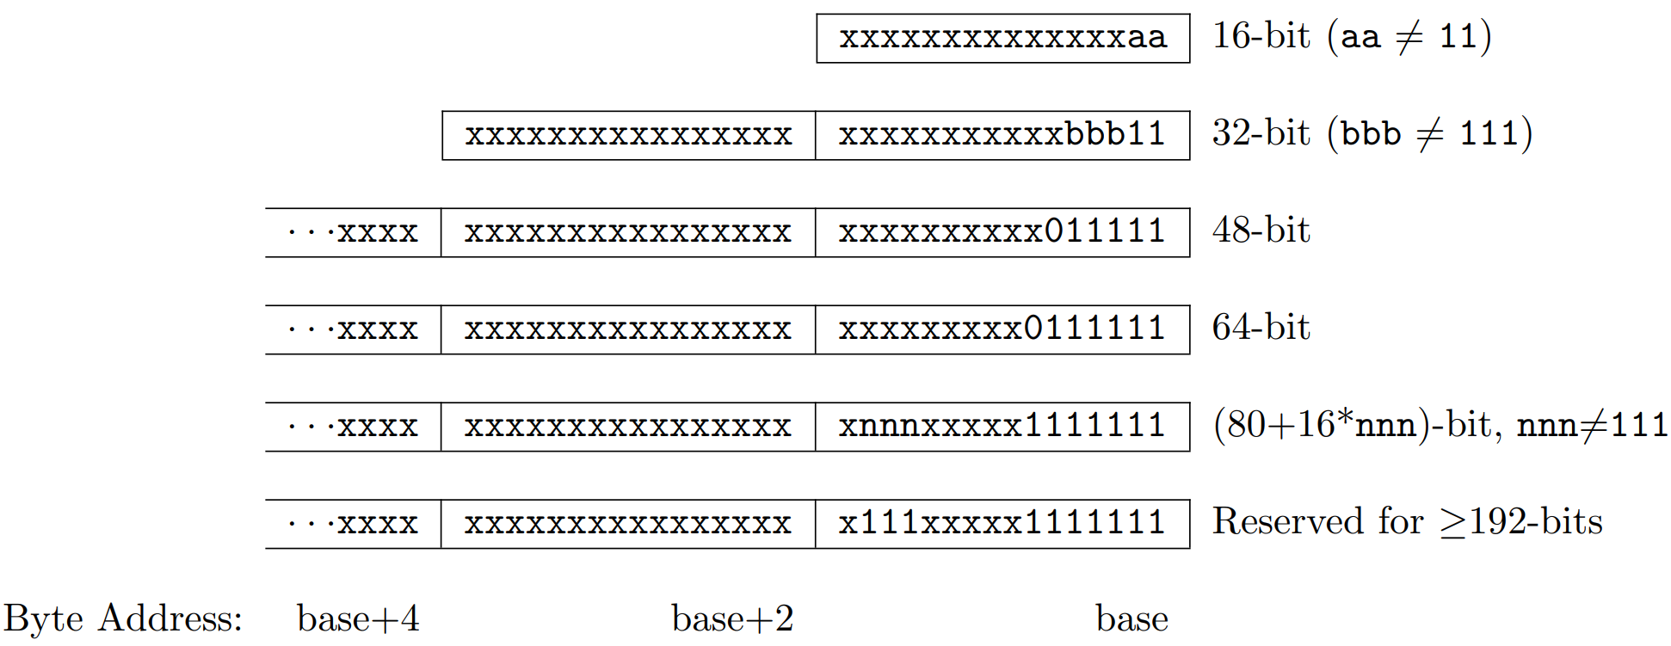
RISC-V Instruction encoding
32-bit fixed-length instructions
Naturally aligned at 32-bit boundaries
Compress extension use 16-bit instructions
Aligned is relaxed to 16-bit boundaries
Variable-length encoding is supported via extensions
Use LSB bits for detection

Slide 24
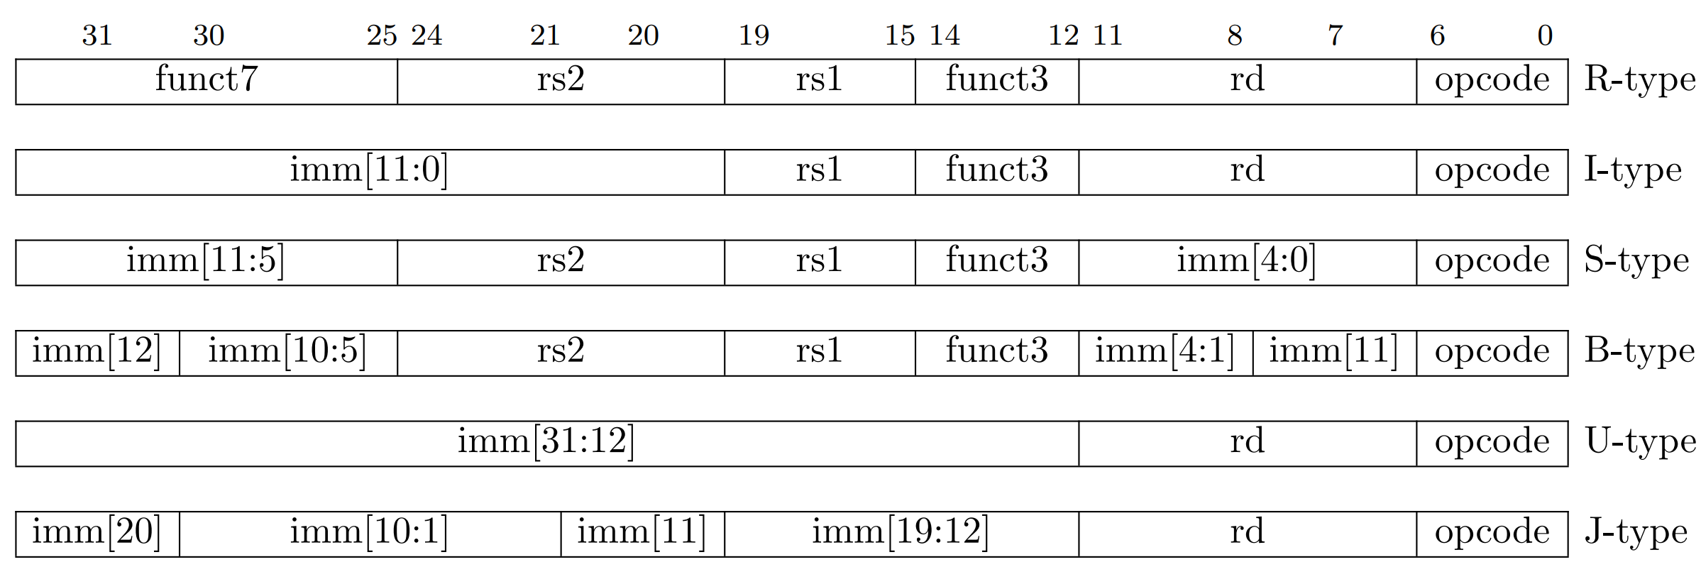
RISC-V Base Instruction Formats
Formats classified based on addressing mode and operation type
R-type: register
I-type: direct
S-type: store
B-type: branch
U-type: immediate
J-type: jump
Notes:
Jumps are unconditional branches

Slide 25
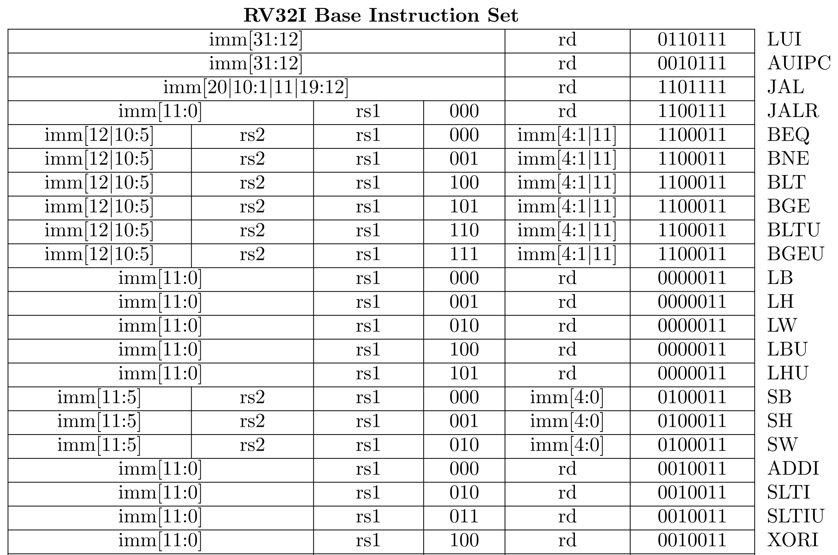
RISC-V Base Instruction Formats (2)
Instructions encoding details
Which opcode?
Which func3 value?
Which func7 value?
See specs chapter 9
Notes:
Jumps are unconditional branches

Slide 26
Background: Integer extension
Motivation: increase the number of bits of a binary number while preserving its value.
Useful for compatibility when using arithmetic units of varying data width.
Zero-extension: append 0’s
e.g. 0xF000 => 0x0000F000
Sing-extension: append 1’s when MSB is 1 and 0’s otherwise
e.g. 0x8000 => 0xFFFF8000 # note that 8 = 1000 where MBS=1
Notes:
Jumps are unconditional branches

Slide 27
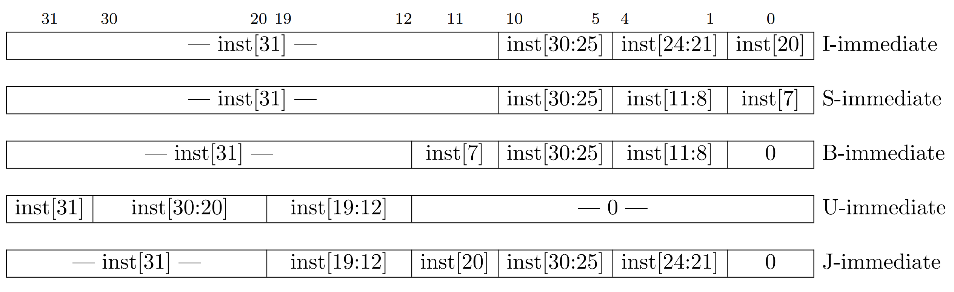
RISC-V Immediate variants
Two immediate lengths
S and B: 12 bits
U and J: 20 bits
Sign-extension
Fixed location for sign-bit in Inst[31] to enable sign-extension to execute in parallel
Notes:
Jumps are unconditional branches

Slide 28
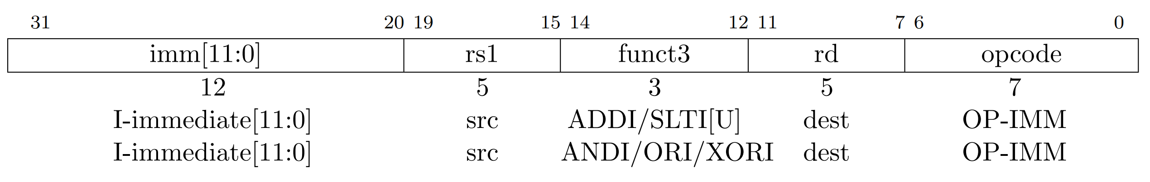
RISC-V Integer Register-Immediate Instructions
ADDI: adds the sign-extended 12-bit sign-extended immediate to rs1
NOP is pseudo instruction: encoded as ADDI x0, x0, 0
SLTI: set less than immediate – set rd to 1 if rs1 < sign-extended immediate
SLTU: set less than immediate – set rd to 1 if rs1 < unsigned immediate
ANDI, ORI, XORI; bitwise logical operations with 12-bit sign-extended immediate and rs1
Example: given opcode = 0010011 & func3 = 010, “SLTI x6, x5, 2” is encoded as
instruction word = 000000000010-00101-010-00110-0010011 = 0x0022A313
Notes:
Jumps are unconditional branches

Slide 29
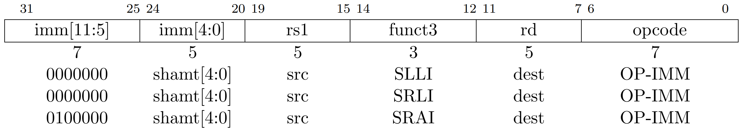
RISC-V Integer Register-Immediate Instructions
SLLI: left-shift rs1 left by 5-bit immediate
SRLI: right-shift rs1 left by 5-bit immediate
SRAI: arithmetic right-shift rs1 left by 5-bit immediate
Notes:
Jumps are unconditional branches

Slide 30
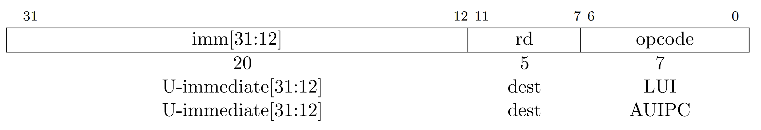
RISC-V Load Immediate
LUI: move 20-bit unsigned immediate into upper 20 bits on rd and zero lower 12 bits
Rd = signed(imm20 << 12)
Useful for loading immediate values into a register
AUIPC: add upper immediate to PC
Rd = signed(imm20 << 12) + PC
Useful for computing a branch target address
Notes:
Jumps are unconditional branches

Slide 31
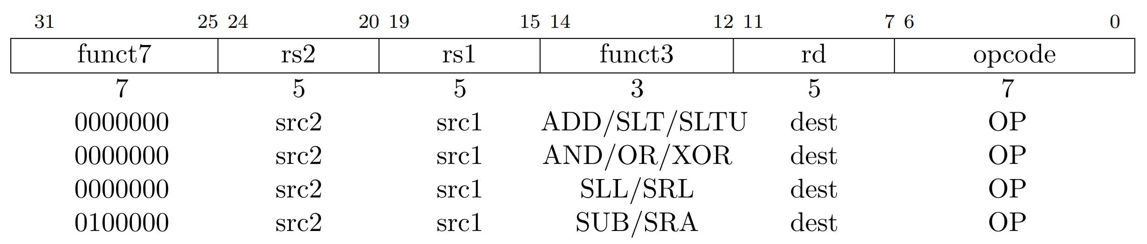
RISC-V Register-Register Operations
ADD, SUB: addition and subtraction using register operands
SLL, SRL, SRA: Shift operations using register operands
Notes:
Jumps are unconditional branches

Slide 32
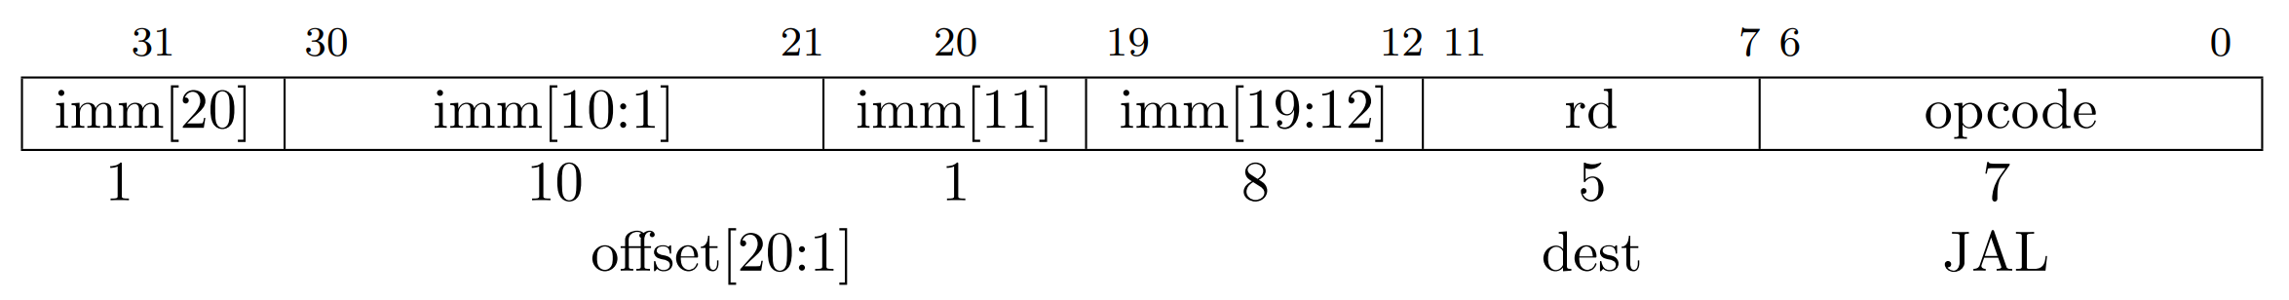
RISC-V Control transfer Instructions
JAL: Plain unconditional jumps
Target address = sign-extended 12-bit immediate
Link register rd
If (rd != 0) PC + 4 is written into rd
Notes:
Jumps are unconditional branches

Slide 33
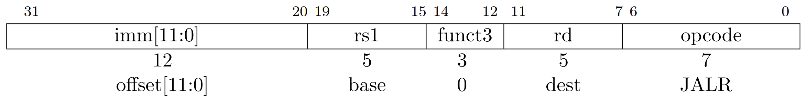
RISC-V Control transfer Instructions
JALR: indirect jump
Target address = sign-extended 12-bit immediate + src1
Link register rd
If (rd != 0) PC + 4 is written into rd
Notes:
Jumps are unconditional branches

Slide 34
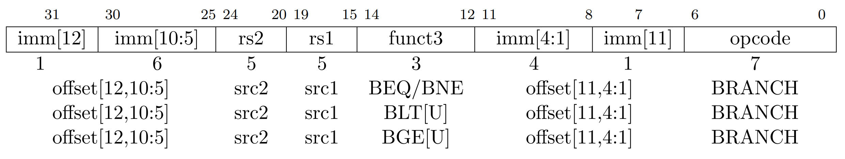
RISC-V Control transfer Instructions
Conditional branches
Compare rs1 and rs2
Target address = sign-extended 12-bit immediate + PC
Notes:
Jumps are unconditional branches

